Slide 1
Exponential Smoothing Methods

Slide 2
Chapter Topics
Introduction to exponential smoothing
Simple Exponential Smoothing
Holt’s Trend Corrected Exponential Smoothing
Holt-Winters Methods
  Multiplicative Holt-Winters method
  Additive Holt-Winters method

Slide 3
Motivation of Exponential Smoothing
Simple moving average method assigns equal weights (1/k) to all k data points.
Arguably, recent observations provide more relevant information than do observations in the past.
So we want a weighting scheme that assigns decreasing weights to the more distant observations.

Slide 4
Exponential Smoothing
Exponential smoothing methods give larger weights to more recent observations, and the weights decrease exponentially as the observations become more distant.
These methods are most effective when the parameters describing the time series are changing SLOWLY over time.

Slide 5
Data vs Methods
No trend or
seasonal
pattern?
Linear trend
and no seasonal
pattern?
Both trend
and seasonal
pattern?
N
N
N
Y
Y
Y
Single
Exponential
Smoothing
Method
Holt’s Trend
Corrected
Exponential
Smoothing
Method
Holt-Winters
Methods
Use Other
Methods

Slide 6
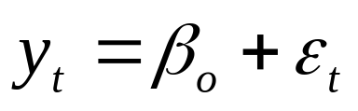
Simple Exponential Smoothing
The Simple Exponential Smoothing method is used for forecasting a time series when there is no trend or seasonal pattern, but the mean (or level) of the time series y_{t} is slowly changing over time.
NO TREND model

Slide 7
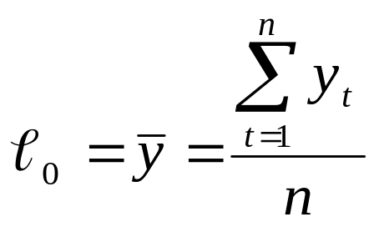
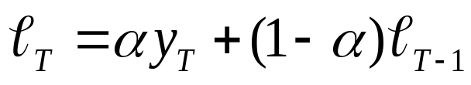
Procedures of Simple Exponential Smoothing Method
Step 1: Compute the initial estimate of the mean (or level) of the series at time period t = 0
Step 2: Compute the updated estimate by using the smoothing equation
where α is a smoothing constant between 0 and 1.

Slide 8
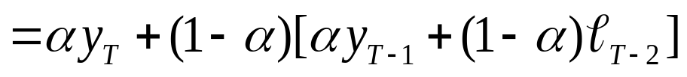
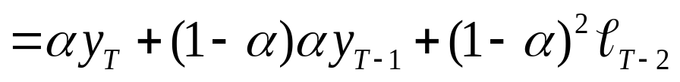
Procedures of Simple Exponential Smoothing Method
Note that
The coefficients measuring the contributions of the observations decrease exponentially over time.

Slide 9

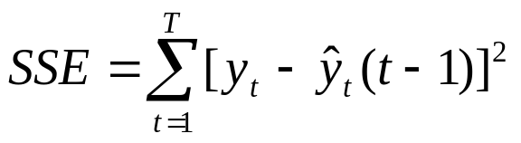

Simple Exponential Smoothing
Point forecast made at time T for y_{T+p}
SSE, MSE, and the standard errors at time T
Note: There is no theoretical justification for dividing SSE by (T – number of smoothing constants). However, we use this divisor because it agrees to the computation of s in Box-Jenkins models introduced later.

Slide 10
Example: Cod Catch
The Bay City Seafood Company recorded the monthly cod catch for the previous two years, as given below.
Cod Catch (In Tons)
Month | Year 1 | Year 2
January | 362 | 276
February | 381 | 334
March | 317 | 394
April | 297 | 334
May | 399 | 384
June | 402 | 314
July | 375 | 344
August | 349 | 337
September | 386 | 345
October | 328 | 362
November | 389 | 314
December | 343 | 365

Slide 11
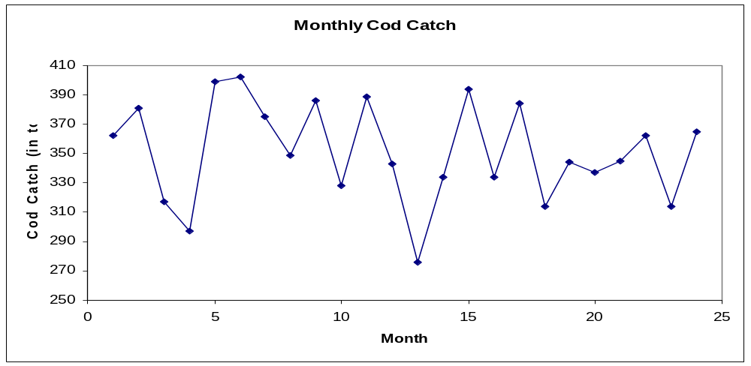
Example: Cod Catch
The plot of these data suggests that there is no trend or seasonal pattern. Therefore, a NO TREND model is suggested:
It is also possible that the mean (or level) is slowly changing over time.

Slide 12
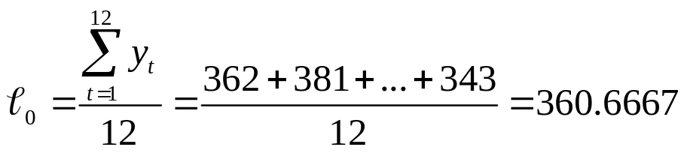
Example: Cod Catch
Step 1: Compute ℓ₀ by averaging the first twelve time series values.
Though there is no theoretical justification, it is a common practice to calculate initial estimates of exponential smoothing procedures by using HALF of the historical data.

Slide 13
Example: Cod Catch
Step 2: Begin with the initial estimate ℓ₀ = 360.6667 and update it by applying the smoothing equation to the 24 observed cod catches.
Set α = 0.1 arbitrarily and judge the appropriateness of this choice of α by the model’s in-sample fit.

Slide 14
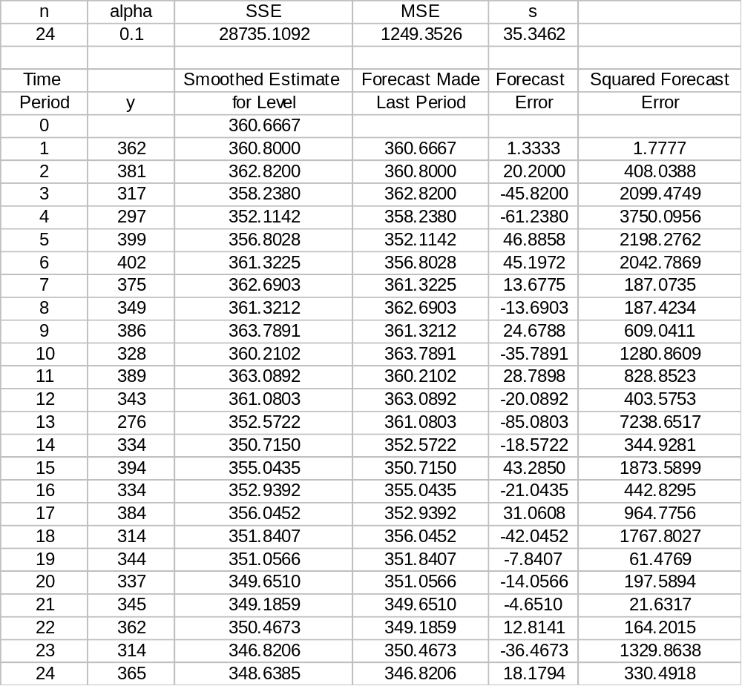
One-period-ahead Forecasting

Slide 15
Example: Cod Catch
Results associated with different values of α
Smoothing Constant | Sum of Squared Errors
0.1 | 28735.11
0.2 | 30771.73
0.3 | 33155.54
0.4 | 35687.69
0.5 | 38364.24
0.6 | 41224.69
0.7 | 44324.09
0.8 | 47734.09

Slide 16
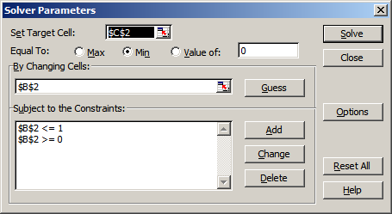
Example: Cod Catch
Step 3: Find a good value of α that provides the minimum value for MSE (or SSE).
  Use Solver in Excel as an illustration
SSE
alpha

Slide 17
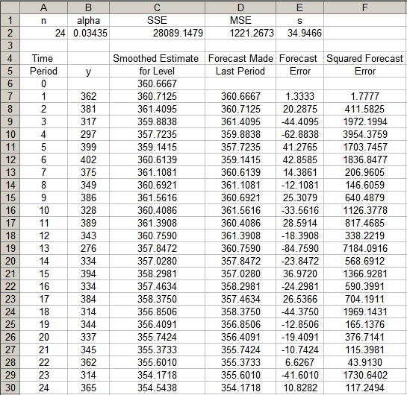
Example: Cod Catch

Slide 18

Holt’s Trend Corrected Exponential Smoothing
If a time series is increasing or decreasing approximately at a fixed rate, then it may be described by the LINEAR TREND model
If the values of the parameters β₀ and β₁ are slowly changing over time, Holt’s trend corrected exponential smoothing method can be applied to the time series observations.
Note: When neither β₀ nor β₁ is changing over time, regression can be used to forecast future values of y_{t}.
Level (or mean) at time T: β₀ + β₁T
Growth rate (or trend): β₁

Slide 19
Holt’s Trend Corrected Exponential Smoothing
A smoothing approach for forecasting such a time series that employs two smoothing constants, denoted by α and γ.
There are two estimates ℓ_{T-1} and b_{T-1}.
  ℓ_{T-1} is the estimate of the level of the time series constructed in time period T–1 (This is usually called the permanent component).
  b_{T-1} is the estimate of the growth rate of the time series constructed in time period T–1 (This is usually called the trend component).

Slide 20


Holt’s Trend Corrected Exponential Smoothing
Level estimate
Trend estimate
where α = smoothing constant for the level (0 ≤ α ≤ 1)
γ = smoothing constant for the trend (0 ≤ γ ≤ 1)

Slide 21

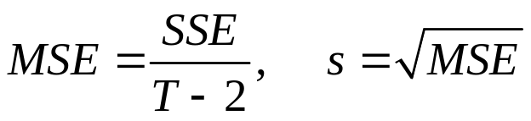
Holt’s Trend Corrected Exponential Smoothing
Point forecast made at time T for y_{T+p}
MSE and the standard error s at time T

Slide 22






Y_{t}
Y_{T+1}
_{T+1}
_{T}
Y_{T}
T － 1
T
T + 1
T + 2

Slide 23
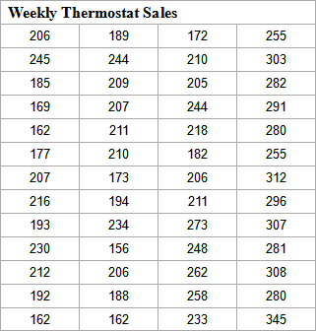
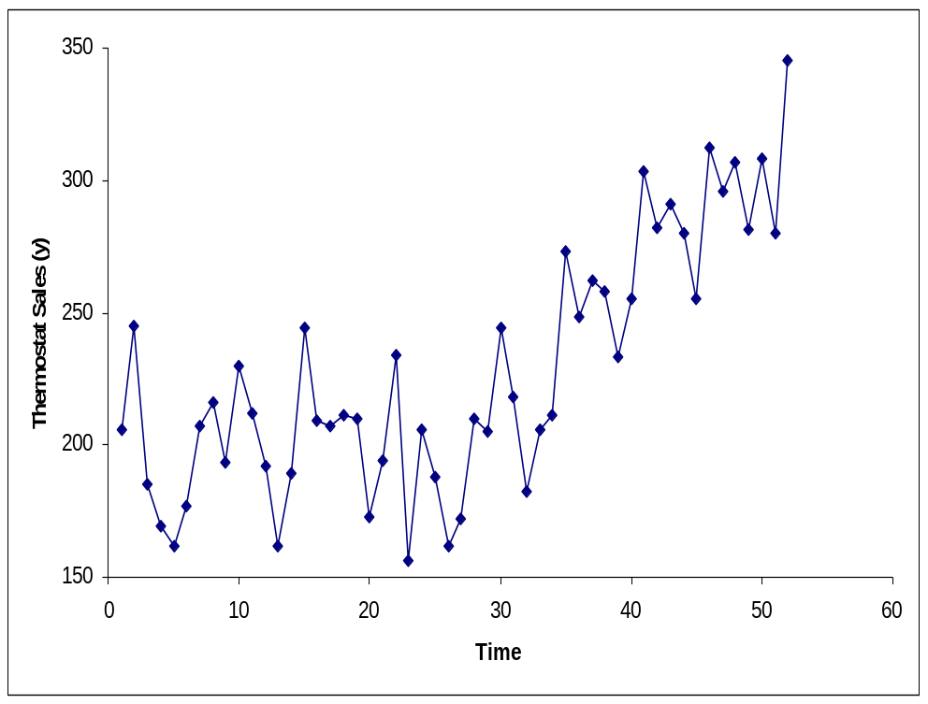
Procedures of Holt’s Trend Corrected Exponential Smoothing
Use the example of Thermostat Sales as an illustration

Slide 24
Procedures of Holt’s Trend Corrected Exponential Smoothing
Findings:
  Overall an upward trend
  The growth rate has been changing over the 52-week period
  There is no seasonal pattern
  ⇒ Holt’s trend corrected exponential smoothing method can be applied

Slide 25
Procedures of Holt’s Trend Corrected Exponential Smoothing
Step 1: Obtain initial estimates ℓ₀ and b₀ by fitting a least squares trend line to HALF of the historical data.
  y-intercept = ℓ₀; slope = b₀

Slide 26
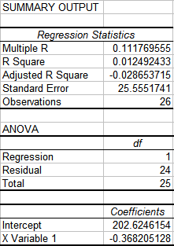

Procedures of Holt’s Trend Corrected Exponential Smoothing
Example
  Fit a least squares trend line to the first 26 observations
  Trend line
  ℓ₀ = 202.6246; b₀ = – 0.3682

Slide 27
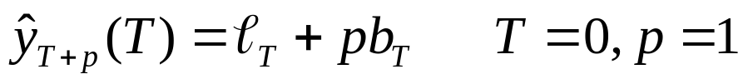
Procedures of Holt’s Trend Corrected Exponential Smoothing
Step 2: Calculate a point forecast of y₁ from time 0
Example

Slide 28
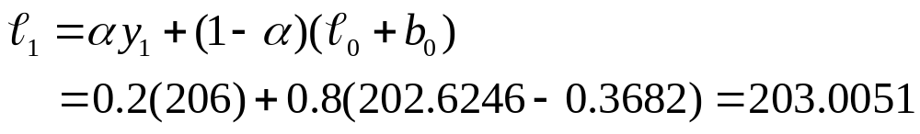
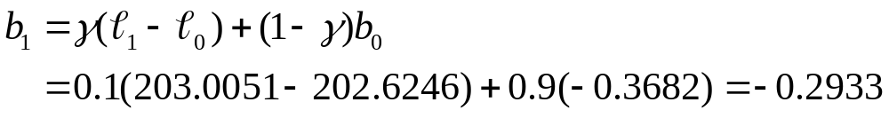
Procedures of Holt’s Trend Corrected Exponential Smoothing
Step 3: Update the estimates ℓ_{T} and b_{T} by using some predetermined values of smoothing constants.
Example: let α = 0.2 and γ = 0.1

Slide 29
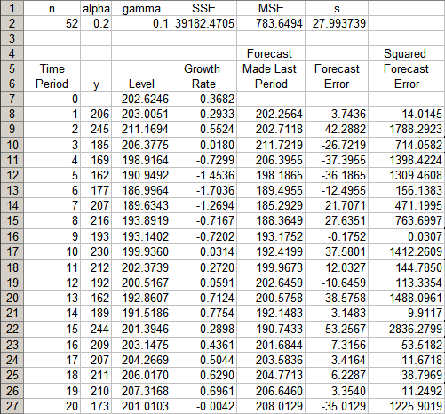
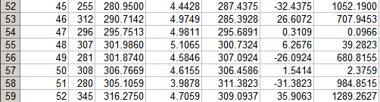
…… ……

Slide 30
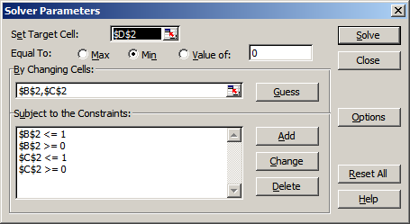
Procedures of Holt’s Trend Corrected Exponential Smoothing
Step 4: Find the best combination of α and γ that minimizes SSE (or MSE)
Example: Use Solver in Excel as an illustration
SSE
alpha
gamma

Slide 31
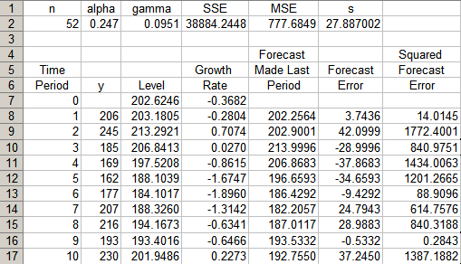
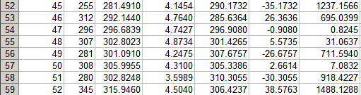
…… ……

Slide 32
Holt’s Trend Corrected Exponential Smoothing
p-step-ahead forecast made at time T
Example
  - In period 52, the one-period-ahead sales forecast for period 53 is
  In period 52, the three-period-ahead sales forecast for period 55 is

Slide 33
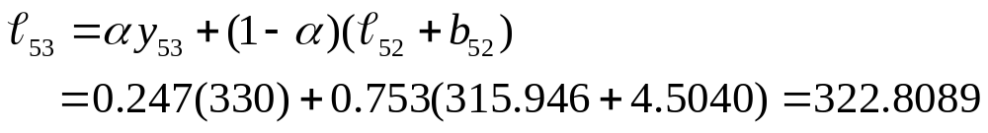
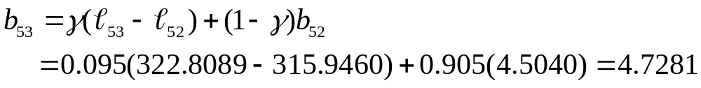
Holt’s Trend Corrected Exponential Smoothing
Example
  If we observe y₅₃ = 330, we can either find a new set of (optimal) α and γ that minimize the SSE for 53 periods, or
  we can simply revise the estimate for the level and growth rate and recalculate the forecasts as follows:

Slide 34
Holt-Winters Methods
Two Holt-Winters methods are designed for time series that exhibit linear trend
- Additive Holt-Winters method: used for time series
with constant (additive) seasonal variations
  Multiplicative Holt-Winters method: used for time series with increasing (multiplicative) seasonal variations
Holt-Winters method is an exponential smoothing approach for handling SEASONAL data.
The multiplicative Holt-Winters method is the better known of the two methods.

Slide 35

Multiplicative Holt-Winters Method
It is generally considered to be best suited to forecasting time series that can be described by the equation:
  SN_{t}: seasonal pattern
  IR_{t}: irregular component
This method is appropriate when a time series has a linear trend with a multiplicative seasonal pattern for which the level (β₀+ β₁t), growth rate (β₁), and the seasonal pattern (SN_{t}) may be slowly changing over time.

Slide 36


Multiplicative Holt-Winters Method
Estimate of the level
Estimate of the growth rate (or trend)
Estimate of the seasonal factor
where α, γ, and δ are smoothing constants between 0 and 1,
L = number of seasons in a year (L = 12 for monthly data, and L = 4 for quarterly data)

Slide 37

Multiplicative Holt-Winters Method
Point forecast made at time T for y_{T+p}
MSE and the standard errors at time T

Slide 38
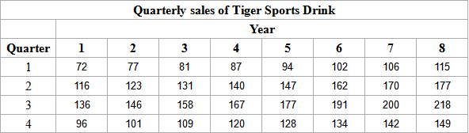
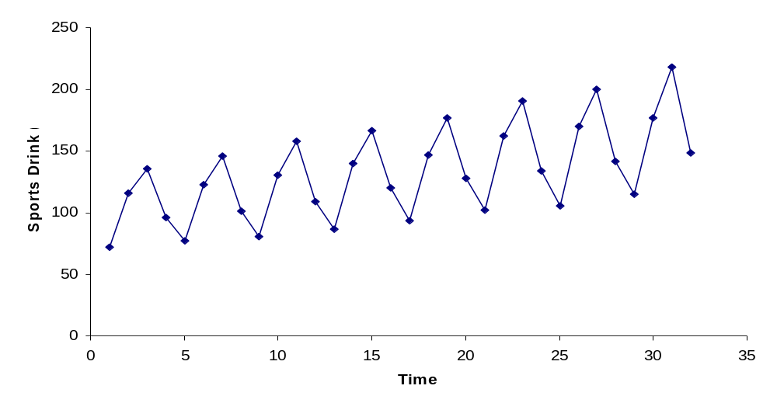
Procedures of Multiplicative Holt-Winters Method
Use the Sports Drink example as an illustration

Slide 39
Procedures of Multiplicative Holt-Winters Method
Observations:
  Linear upward trend over the 8-year period
  Magnitude of the seasonal span increases as the level of the time series increases
  ⇒ Multiplicative Holt-Winters method can be applied to forecast future sales

Slide 40
Procedures of Multiplicative Holt-Winters Method
Step 1: Obtain initial values for the level ℓ₀, the growth rate b₀, and the seasonal factors sn₋₃, sn₋₂, sn₋₁, and sn₀, by fitting a least squares trend line to at least four or five years of the historical data.
  y-intercept = ℓ₀; slope = b₀

Slide 41
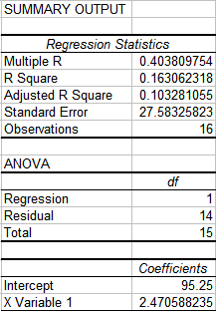

Procedures of Multiplicative Holt-Winters Method
Example
  Fit a least squares trend line to the first 16 observations
  Trend line
  ℓ₀ = 95.2500; b₀ = 2.4706

Slide 42

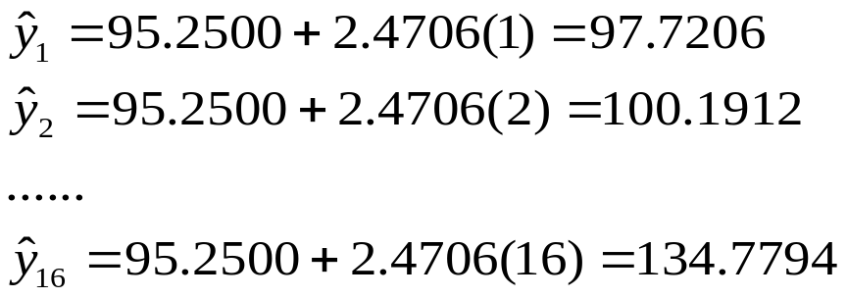
Procedures of Multiplicative Holt-Winters Method
Step 2: Find the initial seasonal factors
  Compute for the in-sample observations used for fitting the regression. In this example, t = 1, 2, …, 16.

Slide 43

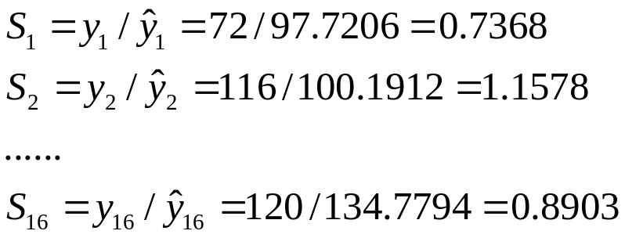
Procedures of Multiplicative Holt-Winters Method
Step 2: Find the initial seasonal factors
  Detrend the data by computing for each time period that is used in finding the least squares regression equation. In this example, t = 1, 2, …, 16.

Slide 44
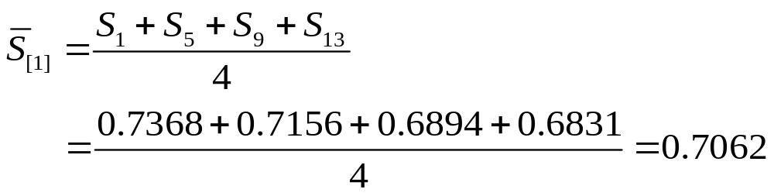
Procedures of Multiplicative Holt-Winters Method
Step 2: Find the initial seasonal factors
  Compute the average seasonal values for each of the L seasons. The L averages are found by computing the average of the detrended values for the corresponding season. For example, for quarter 1,

Slide 45
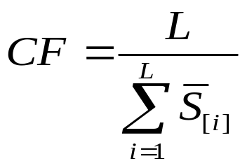

Procedures of Multiplicative Holt-Winters Method
Step 2: Find the initial seasonal factors
  Multiply the average seasonal values by the normalizing constant
  such that the average of the seasonal factors is 1. The initial seasonal factors are

Slide 46
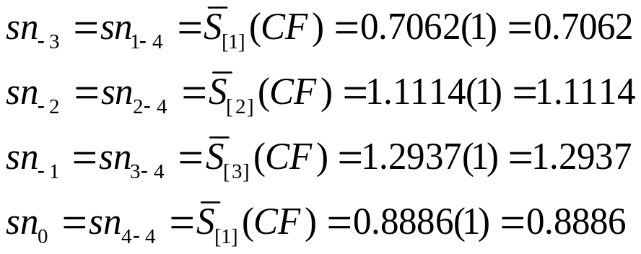
Procedures of Multiplicative Holt-Winters Method
Step 2: Find the initial seasonal factors
  Multiply the average seasonal values by the normalizing constant such that the average of the seasonal factors is 1.
    Example
    CF = 4/3.9999 = 1.0000

Slide 47
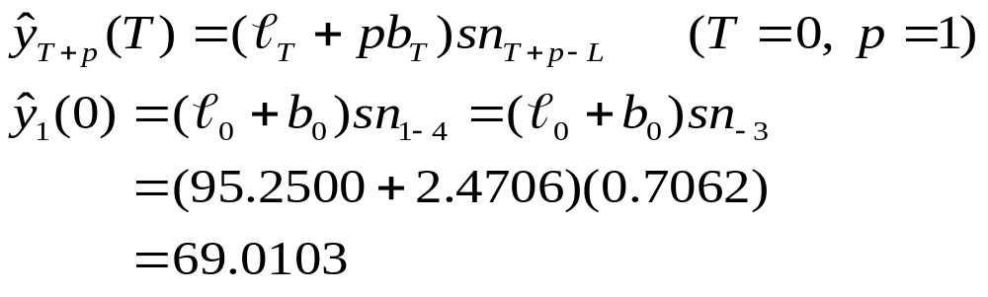
Procedures of Multiplicative Holt-Winters Method
Step 3: Calculate a point forecast of y₁ from time 0 using the initial values

Slide 48
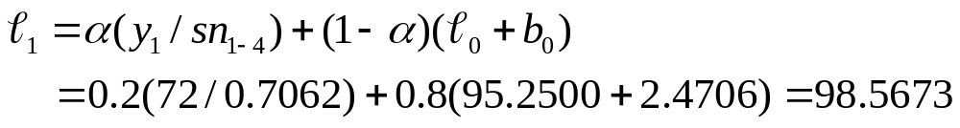
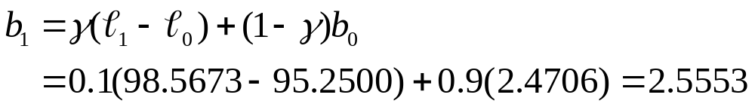
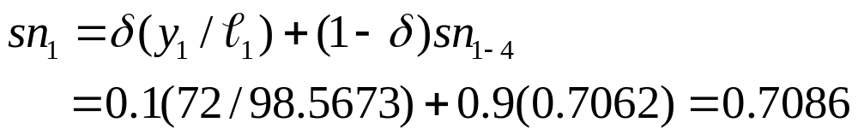
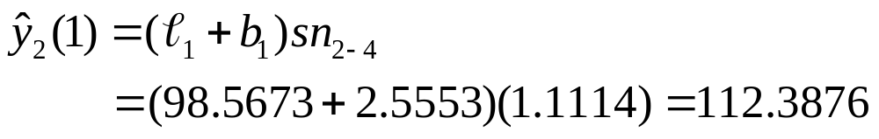
Procedures of Multiplicative Holt-Winters Method
Step 4: Update the estimates ℓ_{T}, b_{T}, and sn_{T} by using some predetermined values of smoothing constants.
Example: let α = 0.2, γ = 0.1, and δ = 0.1

Slide 49
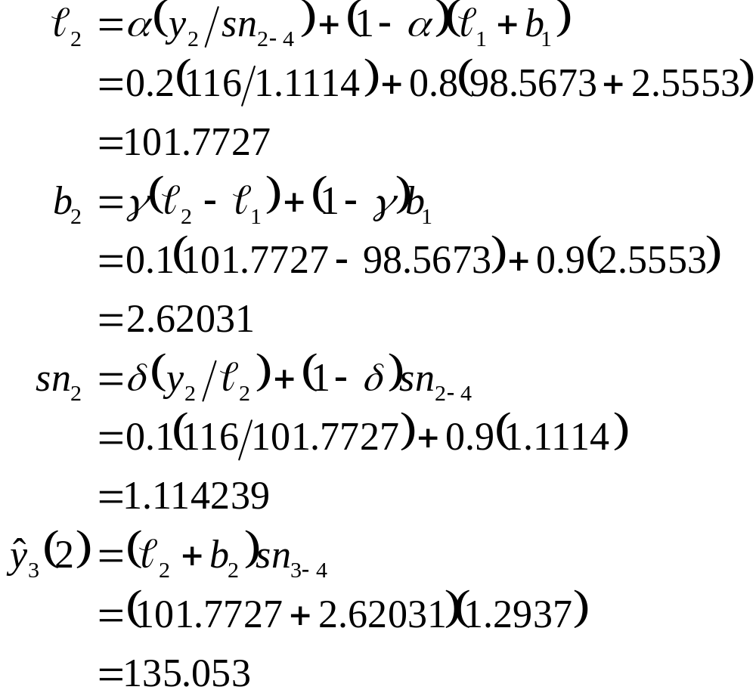

Slide 50
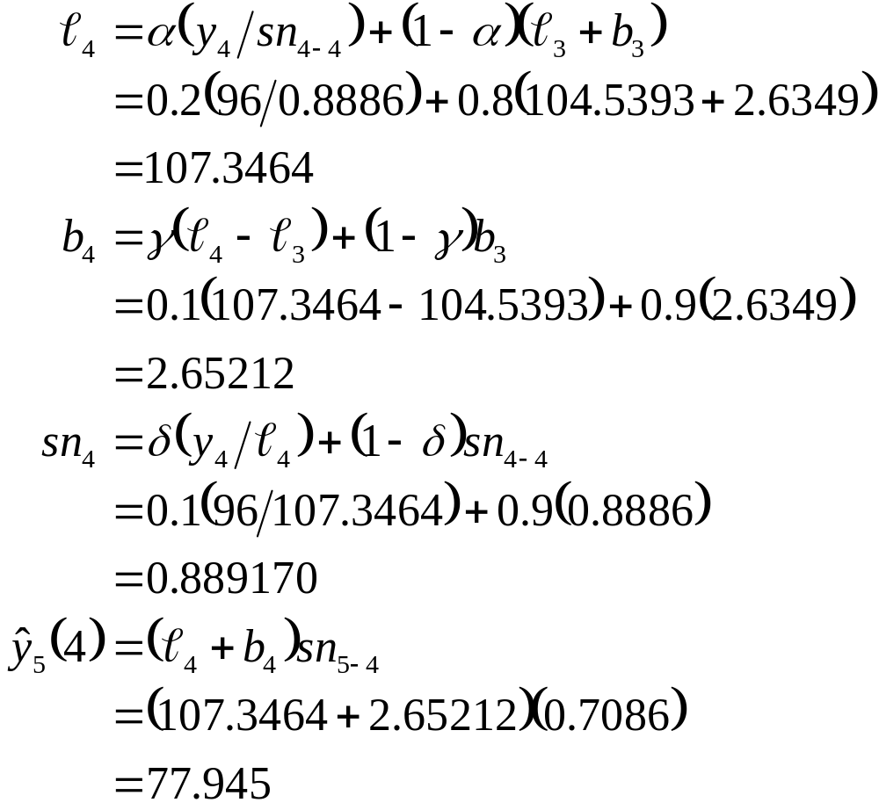

Slide 51
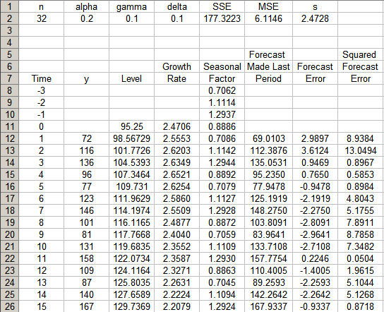
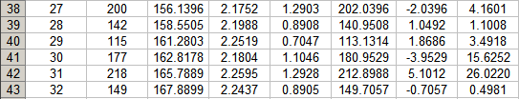
…… ……

Slide 52
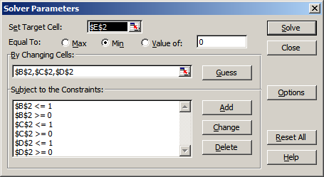
Procedures of Multiplicative Holt-Winters Method
Step 5: Find the most suitable combination of α, γ, and δ that minimizes SSE (or MSE)
Example: Use Solver in Excel as an illustration
SSE
alpha
gamma
delta

Slide 53
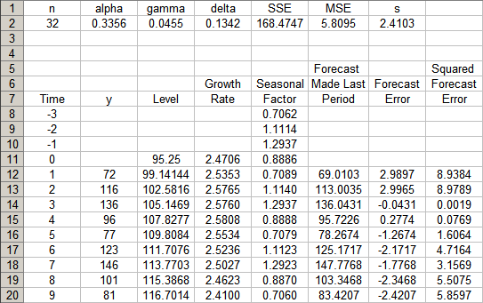
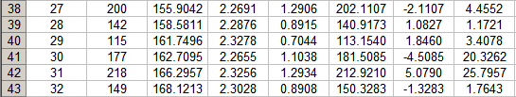
…… ……

Slide 54
Multiplicative Holt-Winters Method
p-step-ahead forecast made at time T
Example

Slide 55
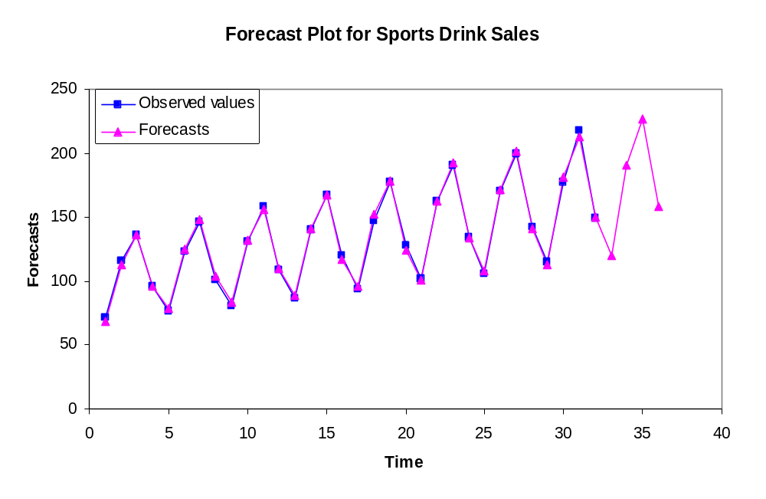
Multiplicative Holt-Winters Method
Example

Slide 56

Additive Holt-Winters Method
It is generally considered to be best suited to forecasting a time series that can be described by the equation:
  SN_{t}: seasonal pattern
  IR_{t}: irregular component
This method is appropriate when a time series has a linear trend with a constant (additive) seasonal pattern such that the level (β₀+ β₁t), growth rate (β₁), and the seasonal pattern (SN_{t}) may be slowly changing over time.

Slide 57


Additive Holt-Winters Method
Estimate of the level
Estimate of the growth rate (or trend)
Estimate of the seasonal factor
where α, γ, and δ are smoothing constants between 0 and 1,
L = number of seasons in a year (L = 12 for monthly data, and L = 4 for quarterly data)

Slide 58
Additive Holt-Winters Method
Point forecast made at time T for y_{T+p}
MSE and the standard error s at time T

Slide 59
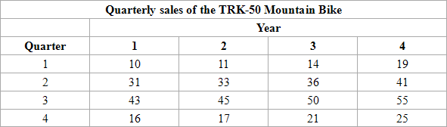
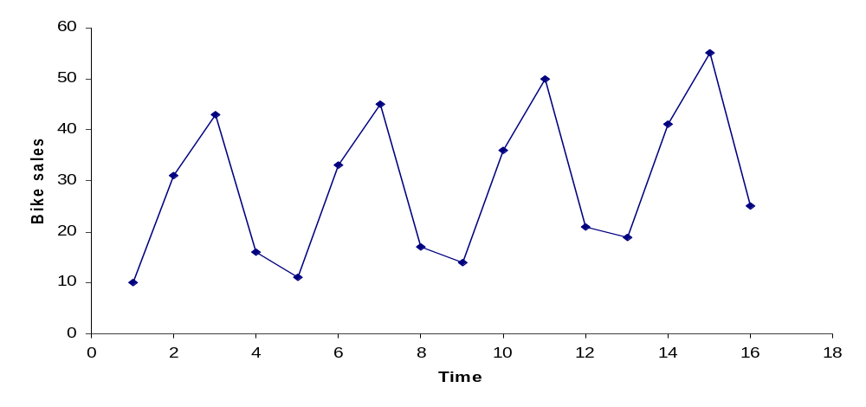
Procedures of Additive Holt-Winters Method
Consider the Mountain Bike example,

Slide 60
Procedures of Additive Holt-Winters Method
Observations:
  Linear upward trend over the 4-year period
  Magnitude of seasonal span is almost constant as the level of the time series increases
  ⇒ Additive Holt-Winters method can be applied to forecast future sales

Slide 61
Procedures of Additive Holt-Winters Method
Step 1: Obtain initial values for the level ℓ₀, the growth rate b₀, and the seasonal factors sn₋₃, sn₋₂, sn₋₁, and sn₀, by fitting a least squares trend line to at least four or five years of the historical data.
  y-intercept = ℓ₀; slope = b₀

Slide 62
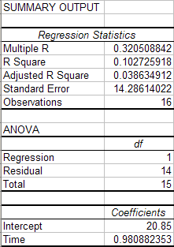

Procedures of Additive Holt-Winters Method
Example
  Fit a least squares trend line to all 16 observations
  Trend line
  ℓ₀ = 20.85; b₀ = 0.9809

Slide 63
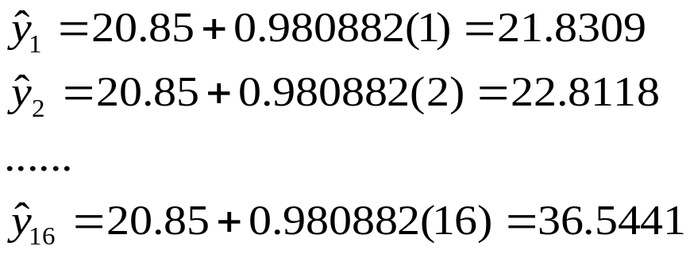
Procedures of Additive Holt-Winters Method
Step 2: Find the initial seasonal factors
  Compute for each time period that is used in finding the least squares regression equation. In this example, t = 1, 2, …, 16.

Slide 64


Procedures of Additive Holt-Winters Method
Step 2: Find the initial seasonal factors
  Detrend the data by computing for each observation used in the least squares fit. In this example, t = 1, 2, …, 16.

Slide 65

Procedures of Additive Holt-Winters Method
Step 2: Find the initial seasonal factors
  Compute the average seasonal values for each of the L seasons. The L averages are found by computing the average of the detrended values for the corresponding season. For example, for quarter 1,

Slide 66

Procedures of Additive Holt-Winters Method
Step 2: Find the initial seasonal factors
  Compute the average of the L seasonal factors. The average should be 0.

Slide 67

Procedures of Additive Holt-Winters Method
Step 3: Calculate a point forecast of y₁ from time 0 using the initial values

Slide 68




Procedures of Additive Holt-Winters Method
Step 4: Update the estimates ℓ_{T}, b_{T}, and sn_{T} by using some predetermined values of smoothing constants.
Example: let α = 0.2, γ = 0.1, and δ = 0.1

Slide 69


Slide 70
Procedures of Additive Holt-Winters Method
Step 5: Find the most suitable combination of α, γ, and δ that minimizes SSE (or MSE)
Example: Use Solver in Excel as an illustration
SSE
alpha
gamma
delta

Slide 71


Slide 72
Additive Holt-Winters Method
p-step-ahead forecast made at time T
Example

Slide 73

Additive Holt-Winters Method
Example

Slide 74
Chapter Summary
Simple Exponential Smoothing
  No trend, no seasonal pattern
Holt’s Trend Corrected Exponential Smoothing
  Trend, no seasonal pattern
Holt-Winters Methods
  Both trend and seasonal pattern
    Multiplicative Holt-Winters method
    Additive Holt-Winters Method

